Slide 1

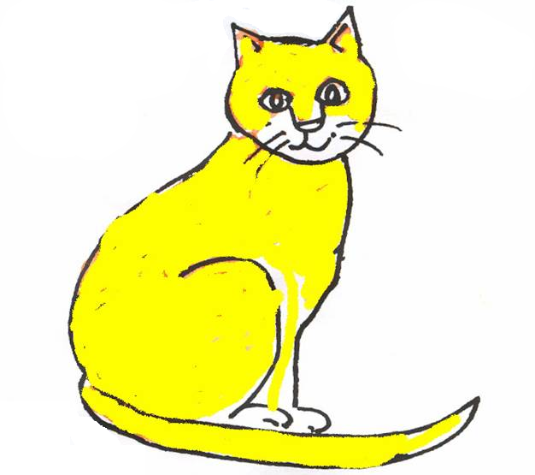
Early Start EALIP Book 2
6 new nouns and 4 colours

Slide 2
Unit 2: 6 more nouns and 4 colours
Key instruction: show me _____ or a _______
Key response: pupil finds card and says ‘yellow’, ’a cat’ etc.
4 colours and 6 more nouns
Activities:
  Name real objects. Point to the relevant pictures in the book. Say ‘a cup’, ‘a bus’, ‘a dog’ … etc., take care to use the indefinite article (the word a or an) each time. Ask the pupil to repeat each time. Make sure they use the article a or an. Say ‘show me a …’ and get pupils to point and name the object, using a or an each time.
  Say the colours. Point to each colour and ask pupils to say the colour. Continue until pupils know the four colours.
  Work in pairs. One pupil can call ‘ a fish’ etc., and the other can show the card.
Key expectations;
  That pupils know 4 colours and 6 new nouns .

Slide 3
How to print sets of pupil flashcards for this book:
Go to file
Then print
Then choose your colour printer
Then choose slides, and in the bar, type 4 – 13 for the pages you want to make the cards from
Under print what, choose handouts
Then click on 6 per page
Go to number of copies to click on how many sets you want
Click preview to check how the cards fit on the pages
Choose the print icon on the top bar of preview page

Slide 4
red

Slide 5
yellow

Slide 6
green

Slide 7
blue

Slide 8

a cup

Slide 9
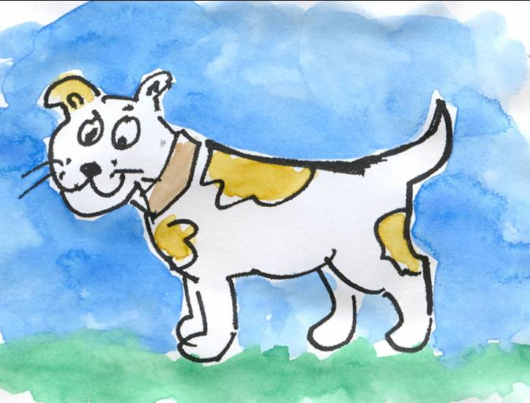
a dog

Slide 10
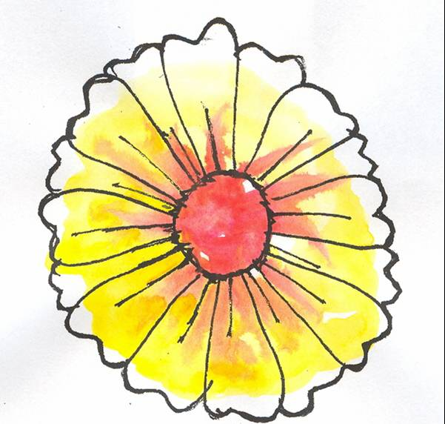
a flower

Slide 11
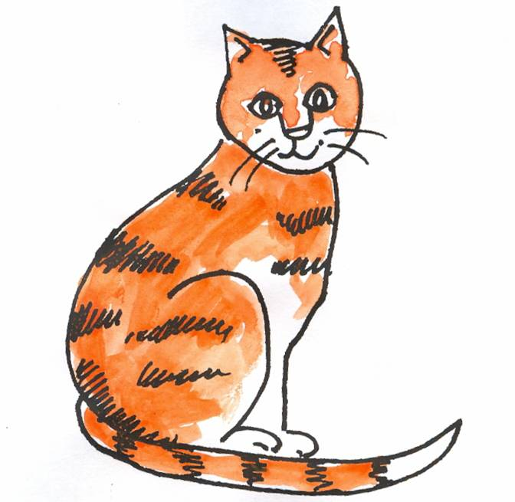
a cat

Slide 12
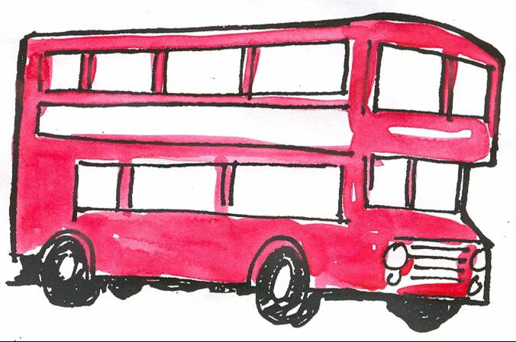
a bus

Slide 13
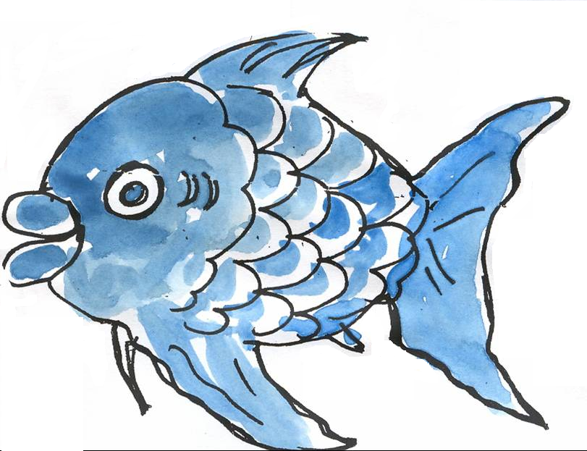
a fish

Slide 14
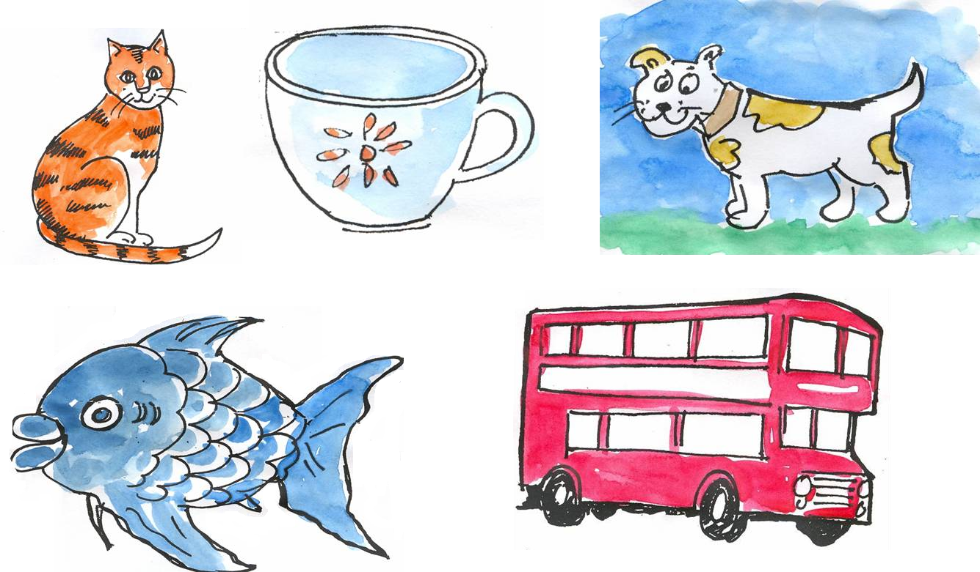
Assessment 2
6 new words
4 colours

Slide 15
Name:
Early Start EALIP
Unit 2:
Six more words and
4 colours
Record of session
Tick for each noun when used with a and each colour learned
a cat
a cup
a dog
a bus
a fish
a flower
red
yellow
blue
Green

