Slide 1
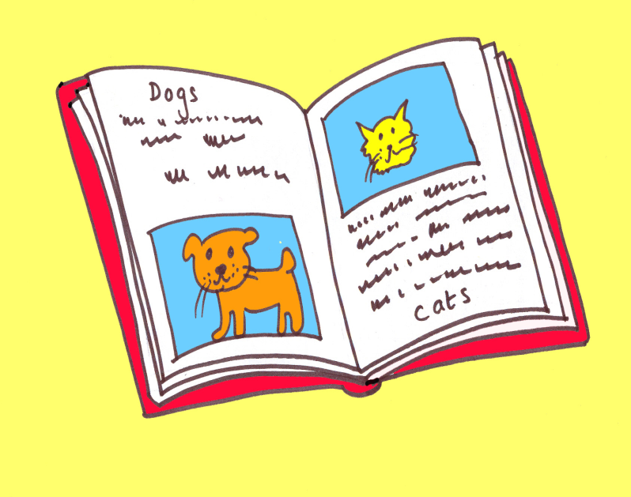
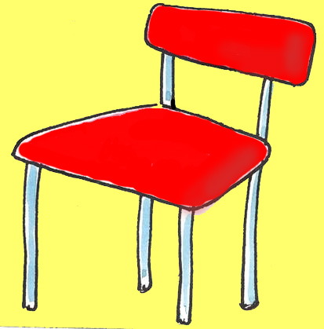

Early Start EALIP Book 1
First 10 Words

Slide 2
Unit 1: Naming an object
Key instruction: show me a …
Key response: pupil points and says ‘a ____’
10 classroom nouns; a jigsaw, a crayon, a book, a chair, a bin, a brush, a table,
a door, window, a box
Activities:
Name real objects. Point to the relevant objects around the classroom. Say a chair, a table, a book … etc., take care to use the indefinite article (the word a or an) each time. Ask the pupil to repeat each time. Make sure he or she uses the article a or an. Say ‘show me a …’ and get pupils to point and name the object, using a or an each time.
Name the pictures. Cut out the pictures, lay them out on the table. Pick up each card naming it ‘a book’, ‘a table’ … etc. and say ‘show me a …’; get the pupils to point to the picture and say ‘a …’
Work in pairs. One pupil can ‘call’, and the other can ‘show’.
Key expectations;
That pupils use the word a before saying each noun.

Slide 3
How to print sets of pupil flashcards for this book:
Go to file
Then print
Then choose your colour printer
Then choose slides, and in the bar, type 4 – 13 for the pages you want to make the cards from.
Under print what, choose handouts
Then click on 6 per page
Go to number of copies to click on how many sets you want
Click preview to check how the cards fit on the pages
Choose the print icon on the top bar of preview page

Slide 4

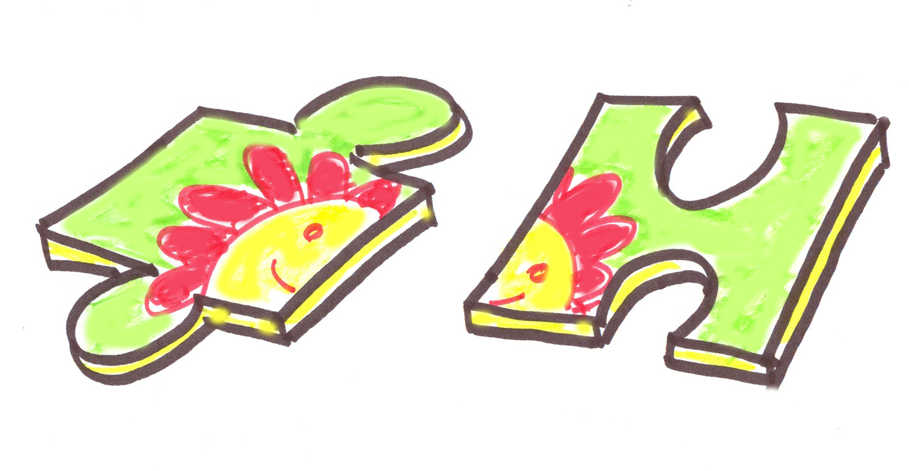


Slide 6
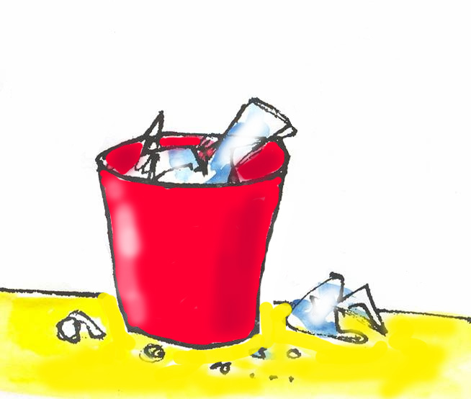

Slide 7


Slide 8


Slide 9
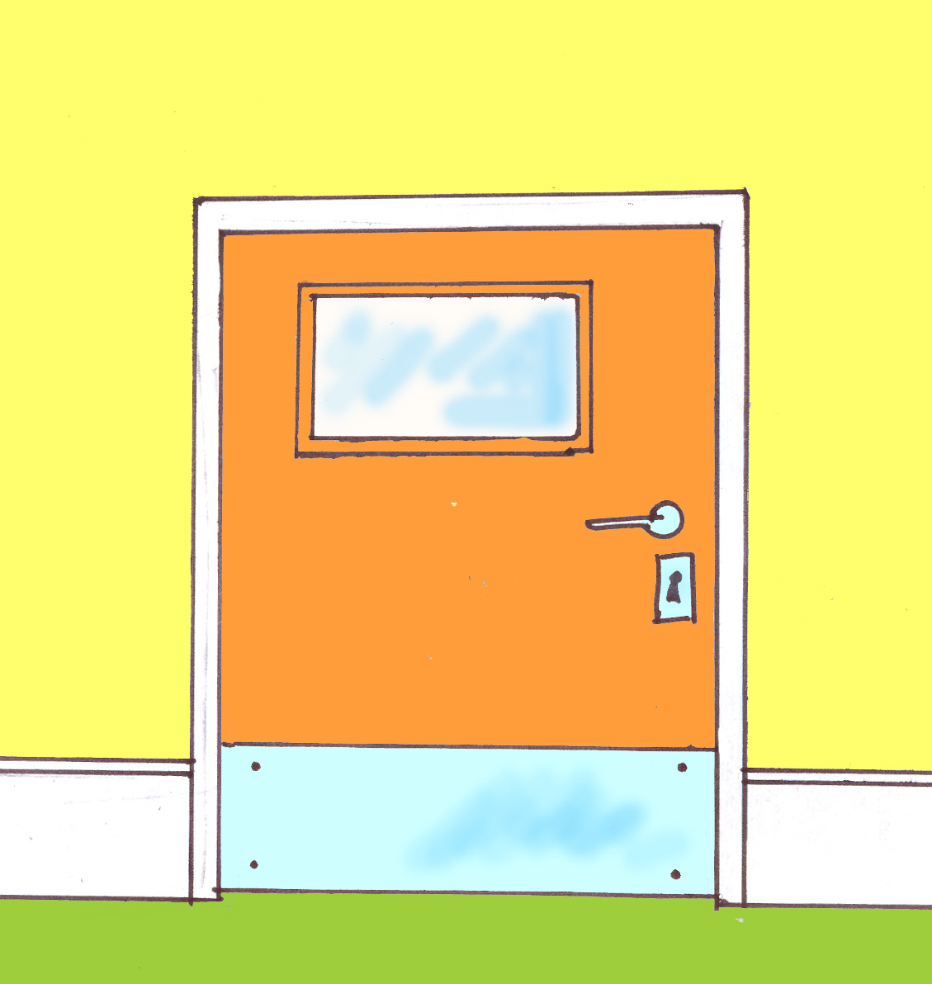

Slide 10
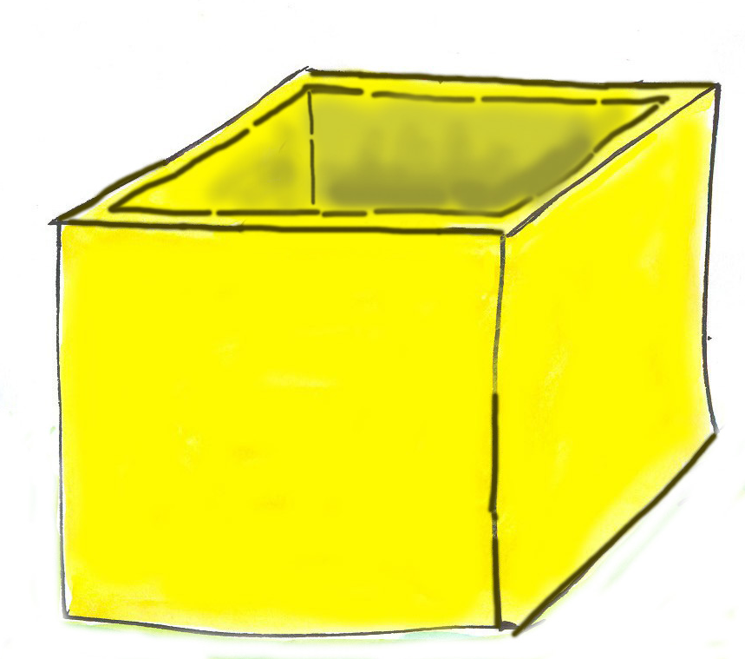

Slide 11
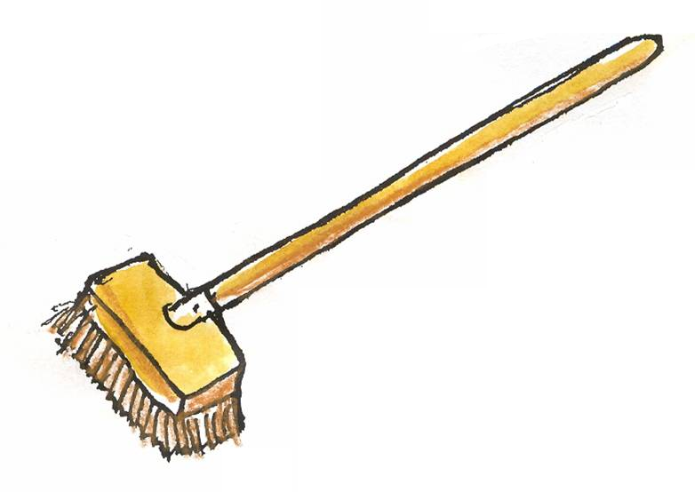

Slide 12
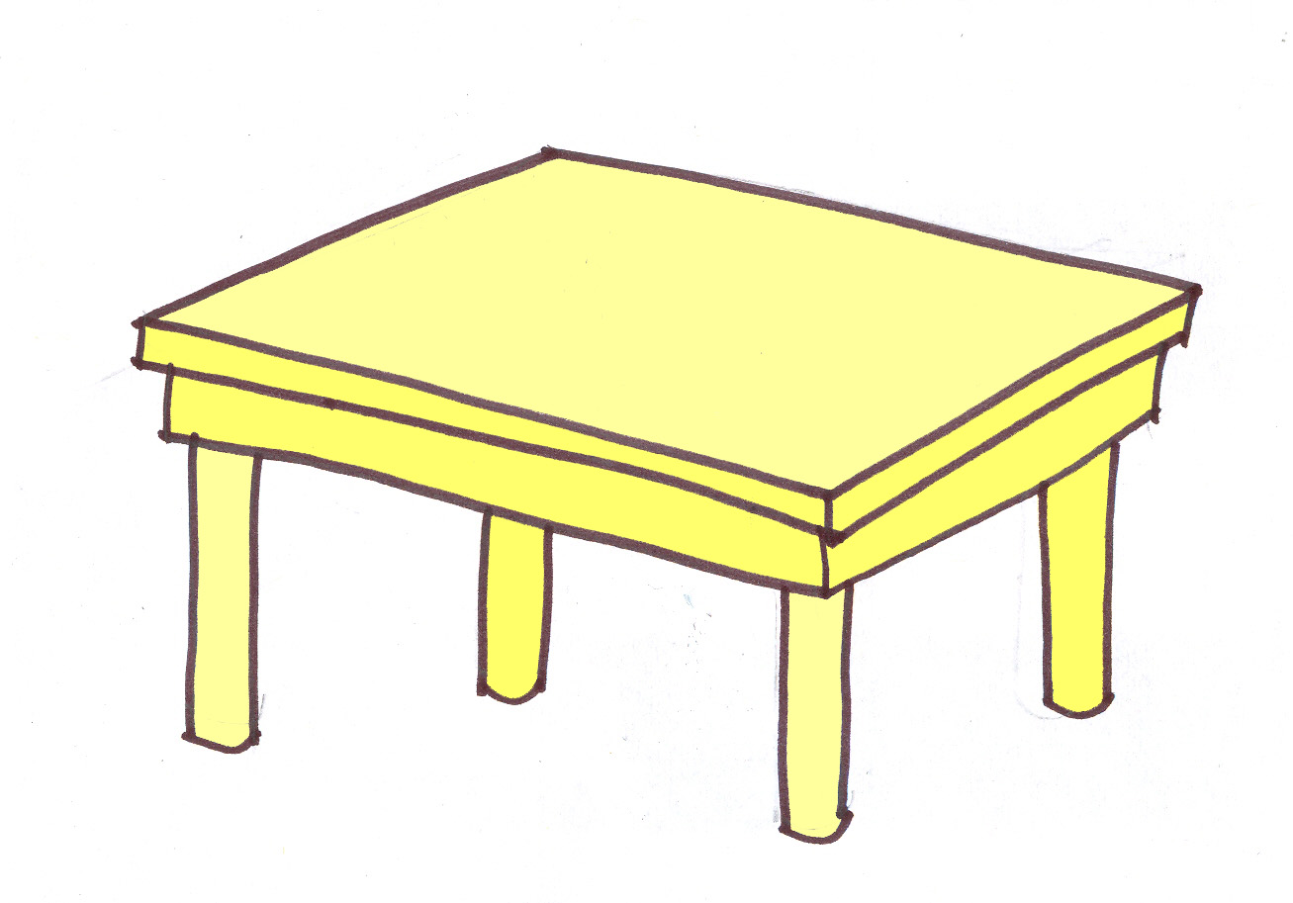

Slide 13


Slide 14





Assessment 1
a first 10 words

Slide 15
Name:
EALIP
Unit 1:
First ten words
Record of session:
Tick for each word learned and used with a
a jigsaw
a chair
a bin
a book
a crayon
a door
a box
a brush
a table
a window

